Slide 1
Report on recent flood disaster in U.A.E due to Incessant rainfall
Kailash V
TIAD4726
Grde-9B

Slide 2
De-Brief on the disaster event
On 16th of April 2024 U.A.E experienced Storm dumps heaviest rain ever recorded in desert nation of UAE
U.A.E received 142MM rainfall only on Tuesday (16-April-24) alone which is much above a 1 year average rainfall of 94.7MM
Due to this the whole U.A.E had got flooded everywhere, people have been disconnected from all facilities like Airport / Public transport / Delivery of essential items / Schools / Road infrastructures / Tourist Attractions etc…….
Whole U.A.E appeared as a island disconnected from world
There were myths where many people were spreading false communication like this disaster was due to the cloud seeding and where the claim of rain due to cloud seeding is baseless and illogical

Slide 3
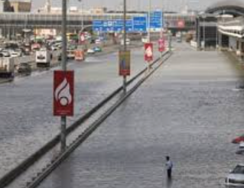
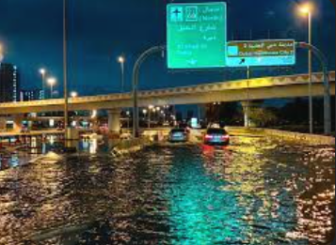
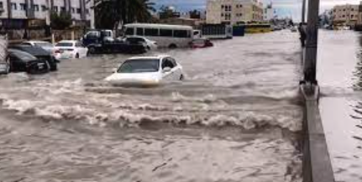
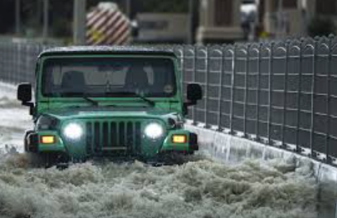
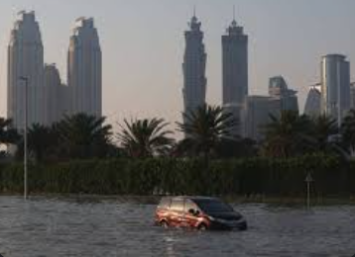

Slide 4
Situation Handling by U.A.E Government
The government alerted the city before the rain . given flash forecast about the rainfall and which was very accurate and due to this many people stayed at home and saved their life.
All Government authorities like Municipality / RTA / DEWA / Volunteers / Airport Authorities have done a tremendous work 24/7 in bringing U.A.E back to its shape.
Due to the Remote Sensing & AI the government has done lot of background works to face this disaster like cleaning of canal and drains, widening the pond and water catchment areas in park etc…. and this has actually saved further damages due to the rain.
Areas worst affected are Al Barsha, Al Khail, Umm Suquiem, Jabal Ali, Discovery Gardens, Airport Tunnel ,Mudan, Arabian Ranches, souq al Kabeer, Abu Shaggara ,al Qasmiya ,al Ittihad Road , JVC , highways E11,E311 & E611.
Dubai took 3 days to fully come back to normal / Abu Dhabi took 2 days to fully come back to normal and Emirate Sharjah took 5 to 7 days to recover and tune back to normal.
Local & Federal Govt has done extraordinary and impressive work for bringing the country back to normal where for any other country it would have taken a very long time to address such issues

Slide 5
Conclusion & Take Away
In the end I am very amazed by the work done by the government. IN future I wish to join as a volunteer to support any initiatives of the government due to the disasters.

